Slide 1
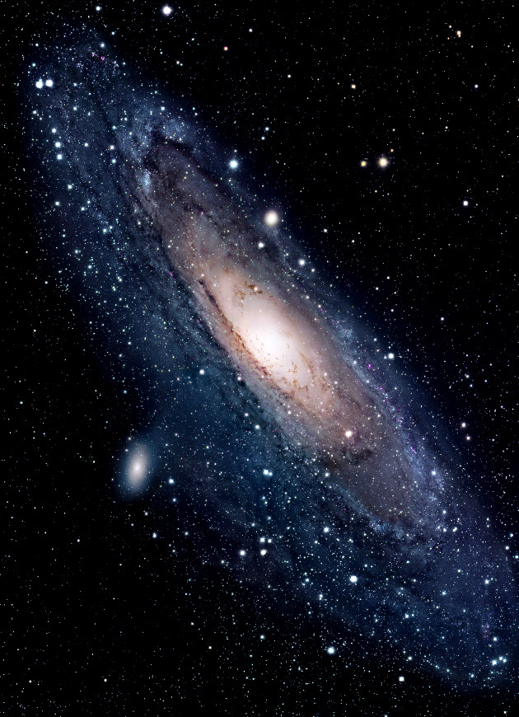
M31
Andromeda Galaxy

Slide 2
Designation: | M31 or NGC 224
Type: | Spiral
Diameter: | 220,000 ly
Distance: | 2.54 Mly
Mass: | 1,230 billion M☉
Number of Stars | 1 trillion
Constellation: | Andromeda
Group: | Local Group
 | 00h 42m 44.3
 | +41° 16′ 9″
Apparent magnitude (V) | 4.5
 | indicates blueshift

Slide 3
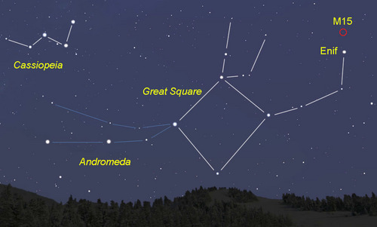
M31
+4.5 Magnitude

Slide 4
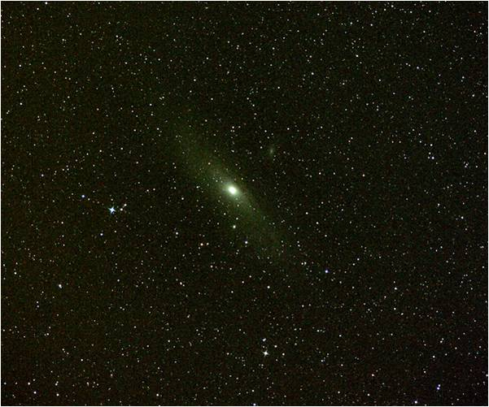
M31 as viewed in small telescope
Actual Angular size
3.167° × 1°
M31
+4.5 Magnitude

Slide 5
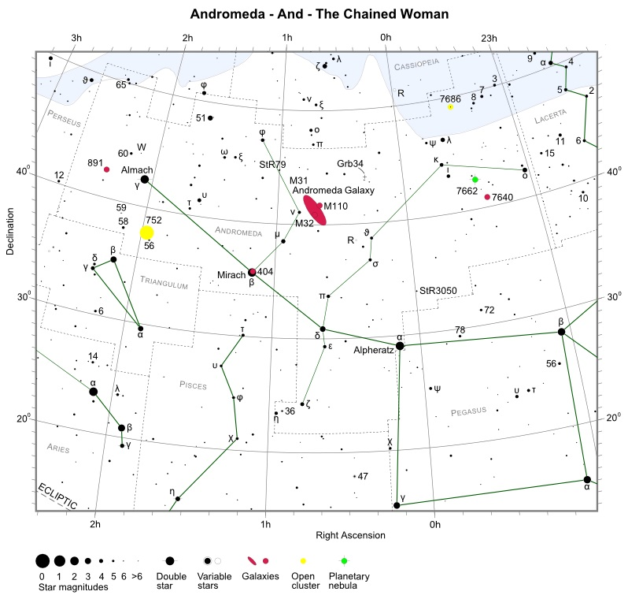

Slide 6
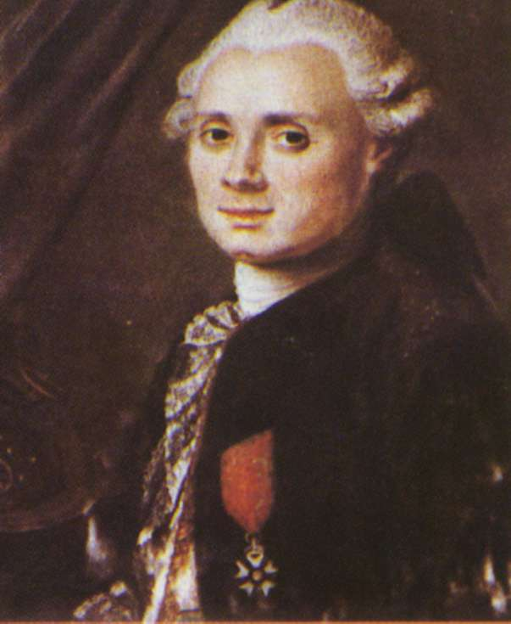
Charles Messier was a French astronomer most notable for publishing an astronomical catalogue consisting of nebulae and star clusters that came to be known as the 110 "Messier objects". The purpose of the catalogue was to help astronomical observers, in particular comet hunters such as himself, distinguish between permanent and transient visually diffuse objects in the sky.
In 1764, Charles Messier included it (Andromeda Galaxy) in his catalogue and labelled it M31.
Charles Messier
Astronomer

